Slide 1
DATA GLACIER
G2M CASE STUDY
CAB INVESTMENT
WEEK 3
16 - FEB - 2O23

Slide 2
BACKGROUND - G2M (CAB INVESTMENT)
Business Problem : XYZ is a private firm in US. Due to remarkable growth in the Cab Industry in last few years and multiple key players in the market, it is planning for an investment in Cab industry and as per their Go-to-Market(G2M) strategy they want to understand the market before taking final decision
Objective : To generate insights to help XYZ identify the right company to make their investment.

Slide 3
DATA EXPLORATION
Assumptions :
Users column in city dataset represents the total number of users of both the yellow and pink cab firm in a particular city.
Data points for the population feature almost differs from the actual population in those cities.
There are outliers in the price charged feature but this is indeed a true outlier which can be caused by many situations one of which may be as a result of extra services provided to the users in the duration of the trip which was not given in the dataset.

Slide 4
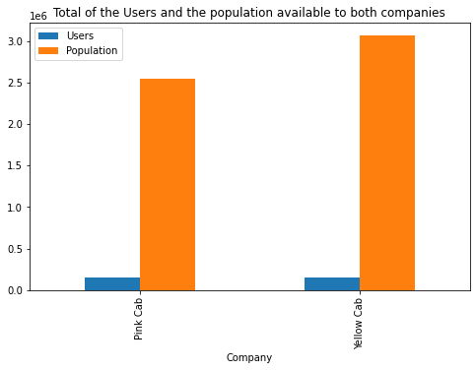
CAB FIRM AVAILABILITY
A larger population of
individuals have Yellow Cab
available to them than Pink Cab

Slide 5
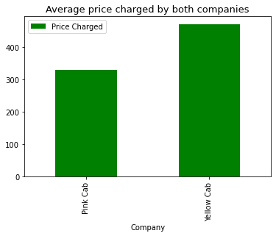
AVERAGE PRICE CHARGED
Yellow cab company
charges slightly more on an average
than the pink cab Company

Slide 6
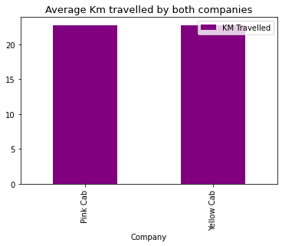
AVERAGE KM TRAVELLED
Both Cab firm travel at almost
same average KM

Slide 7
DISTRIBUTION OF CAB FIRMS’ USERS PER CITY
As we see, a large majority of Yellow cab users are found in NEW YORK NY, CHICAGO IL & WASHINGTON DC with the least amount of users in PITTSBURG CA & SACRAMENTO CA
For Pink Cab we see that it has most of its users in LOS ANGELES CA, NEW YORK NY & SAN DIEGO CA with the least in PHOENIX AZ, PITTSBURG CA & SACRAMENTO CA
Overall we see that yellow cab is more patronised than pink cab in all of the 19 cities.
As shown in the figure below:

Slide 8
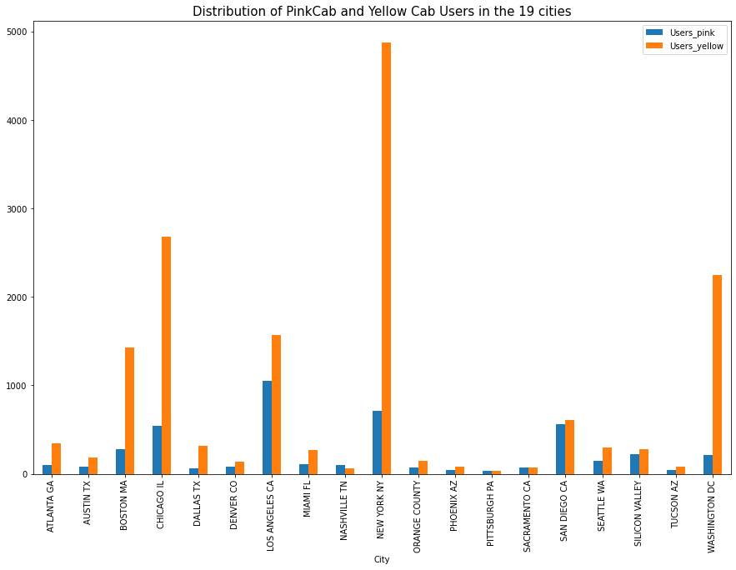
DISTRIBUTION OF CAB FIRMS’ USERS PER CITY CONT’D

Slide 9
DISTRIBUTION OF CAB FIRMS’ USERS PER YEAR
They both recorded the highest number of users in 2017 although the yellow cab company recorded more
users in all the years than the pink cab company(three times as much)
As shown below:

Slide 10
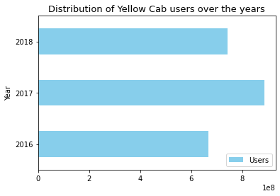
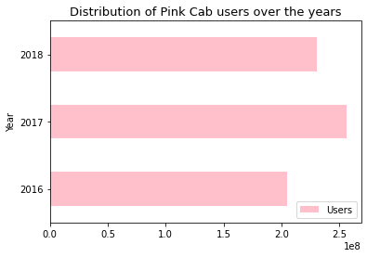

Slide 11
PROFIT ANALYSIS : PROFIT DISTRIBUTION PER CITY
PINK CAB FIRM
As we see the highest percentage of pink cab profits comes from NEW YORK NY, followed
by LOS ANGELES CA & SAN DIEGO
As depicted in the pie chart below:

Slide 12
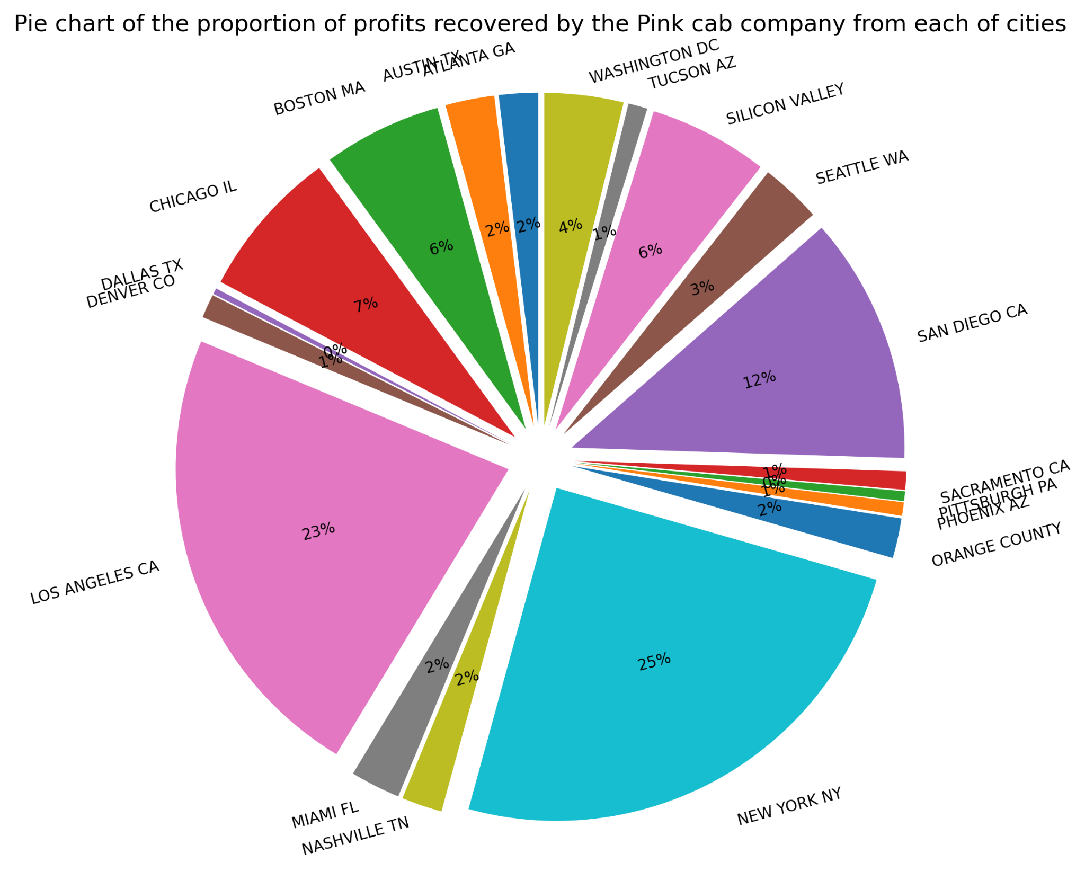

Slide 13
PROFIT ANALYSIS : PROFIT DISTRIBUTION PER CITY CONT’D
YELLOW CAB
As we see, a large majority of Yellow cab users are found in NEW YORK NY, CHICAGO IL & WASHINGTON DC with the least amount of users in PITTSBURG CA & SACRAMENTO CA
As shown in the figure below:

Slide 14
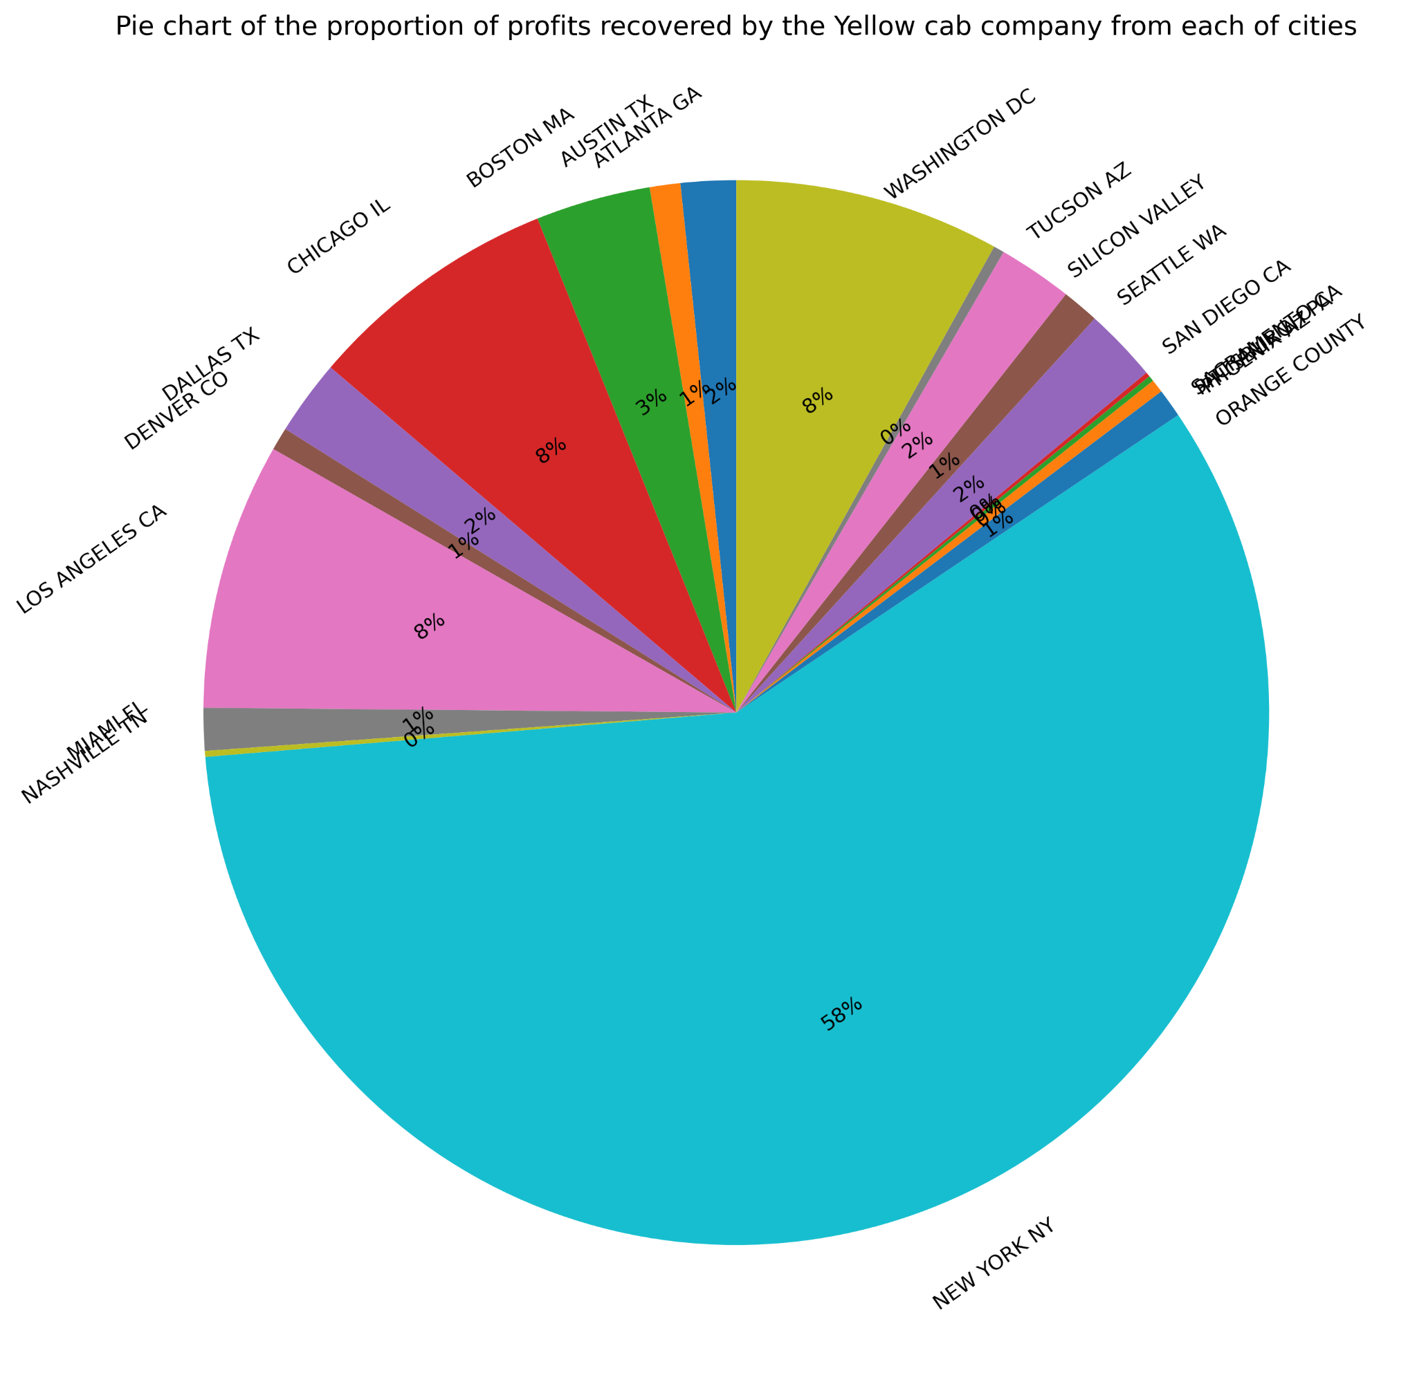

Slide 15
PROFIT ANALYSIS : PROFIT DISTRIBUTION BY HOLIDAY
YELLOW CAB
Highest profits earn by the yellow cab company is on Christmas Eve, New Year's Eve and Labor Day Weekend.
As shown below:

Slide 16
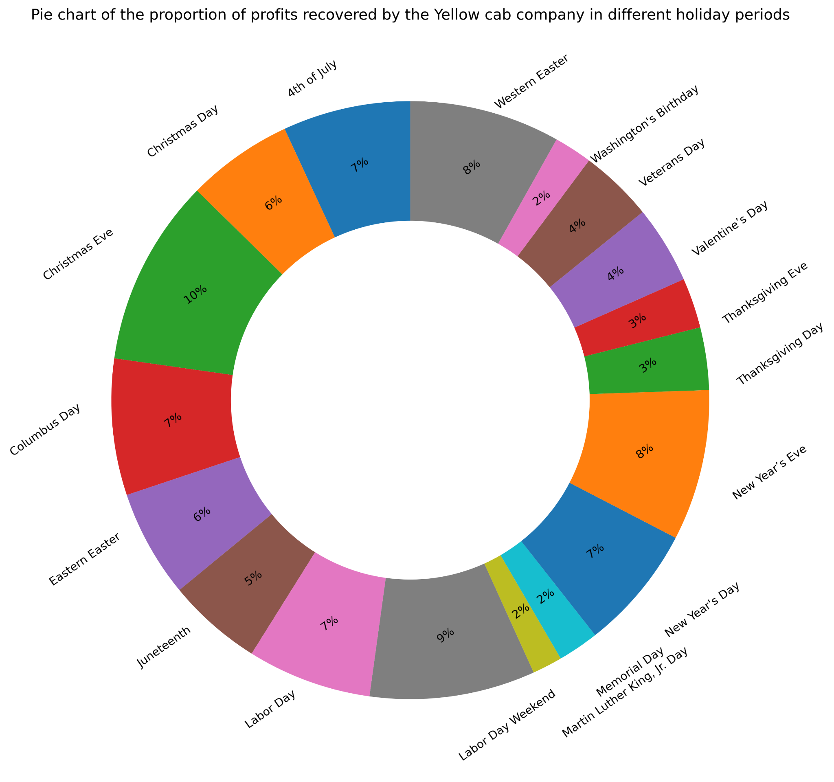

Slide 17
PROFIT ANALYSIS : PROFIT DISTRIBUTION BY HOLIDAY
PINK CAB
For the pink cab company, profits are mostly made on Christmas eve, New year's day, christmas day & new year's eve. However they make more overall on holidays than the yellow cab company.
As shown below :

Slide 18
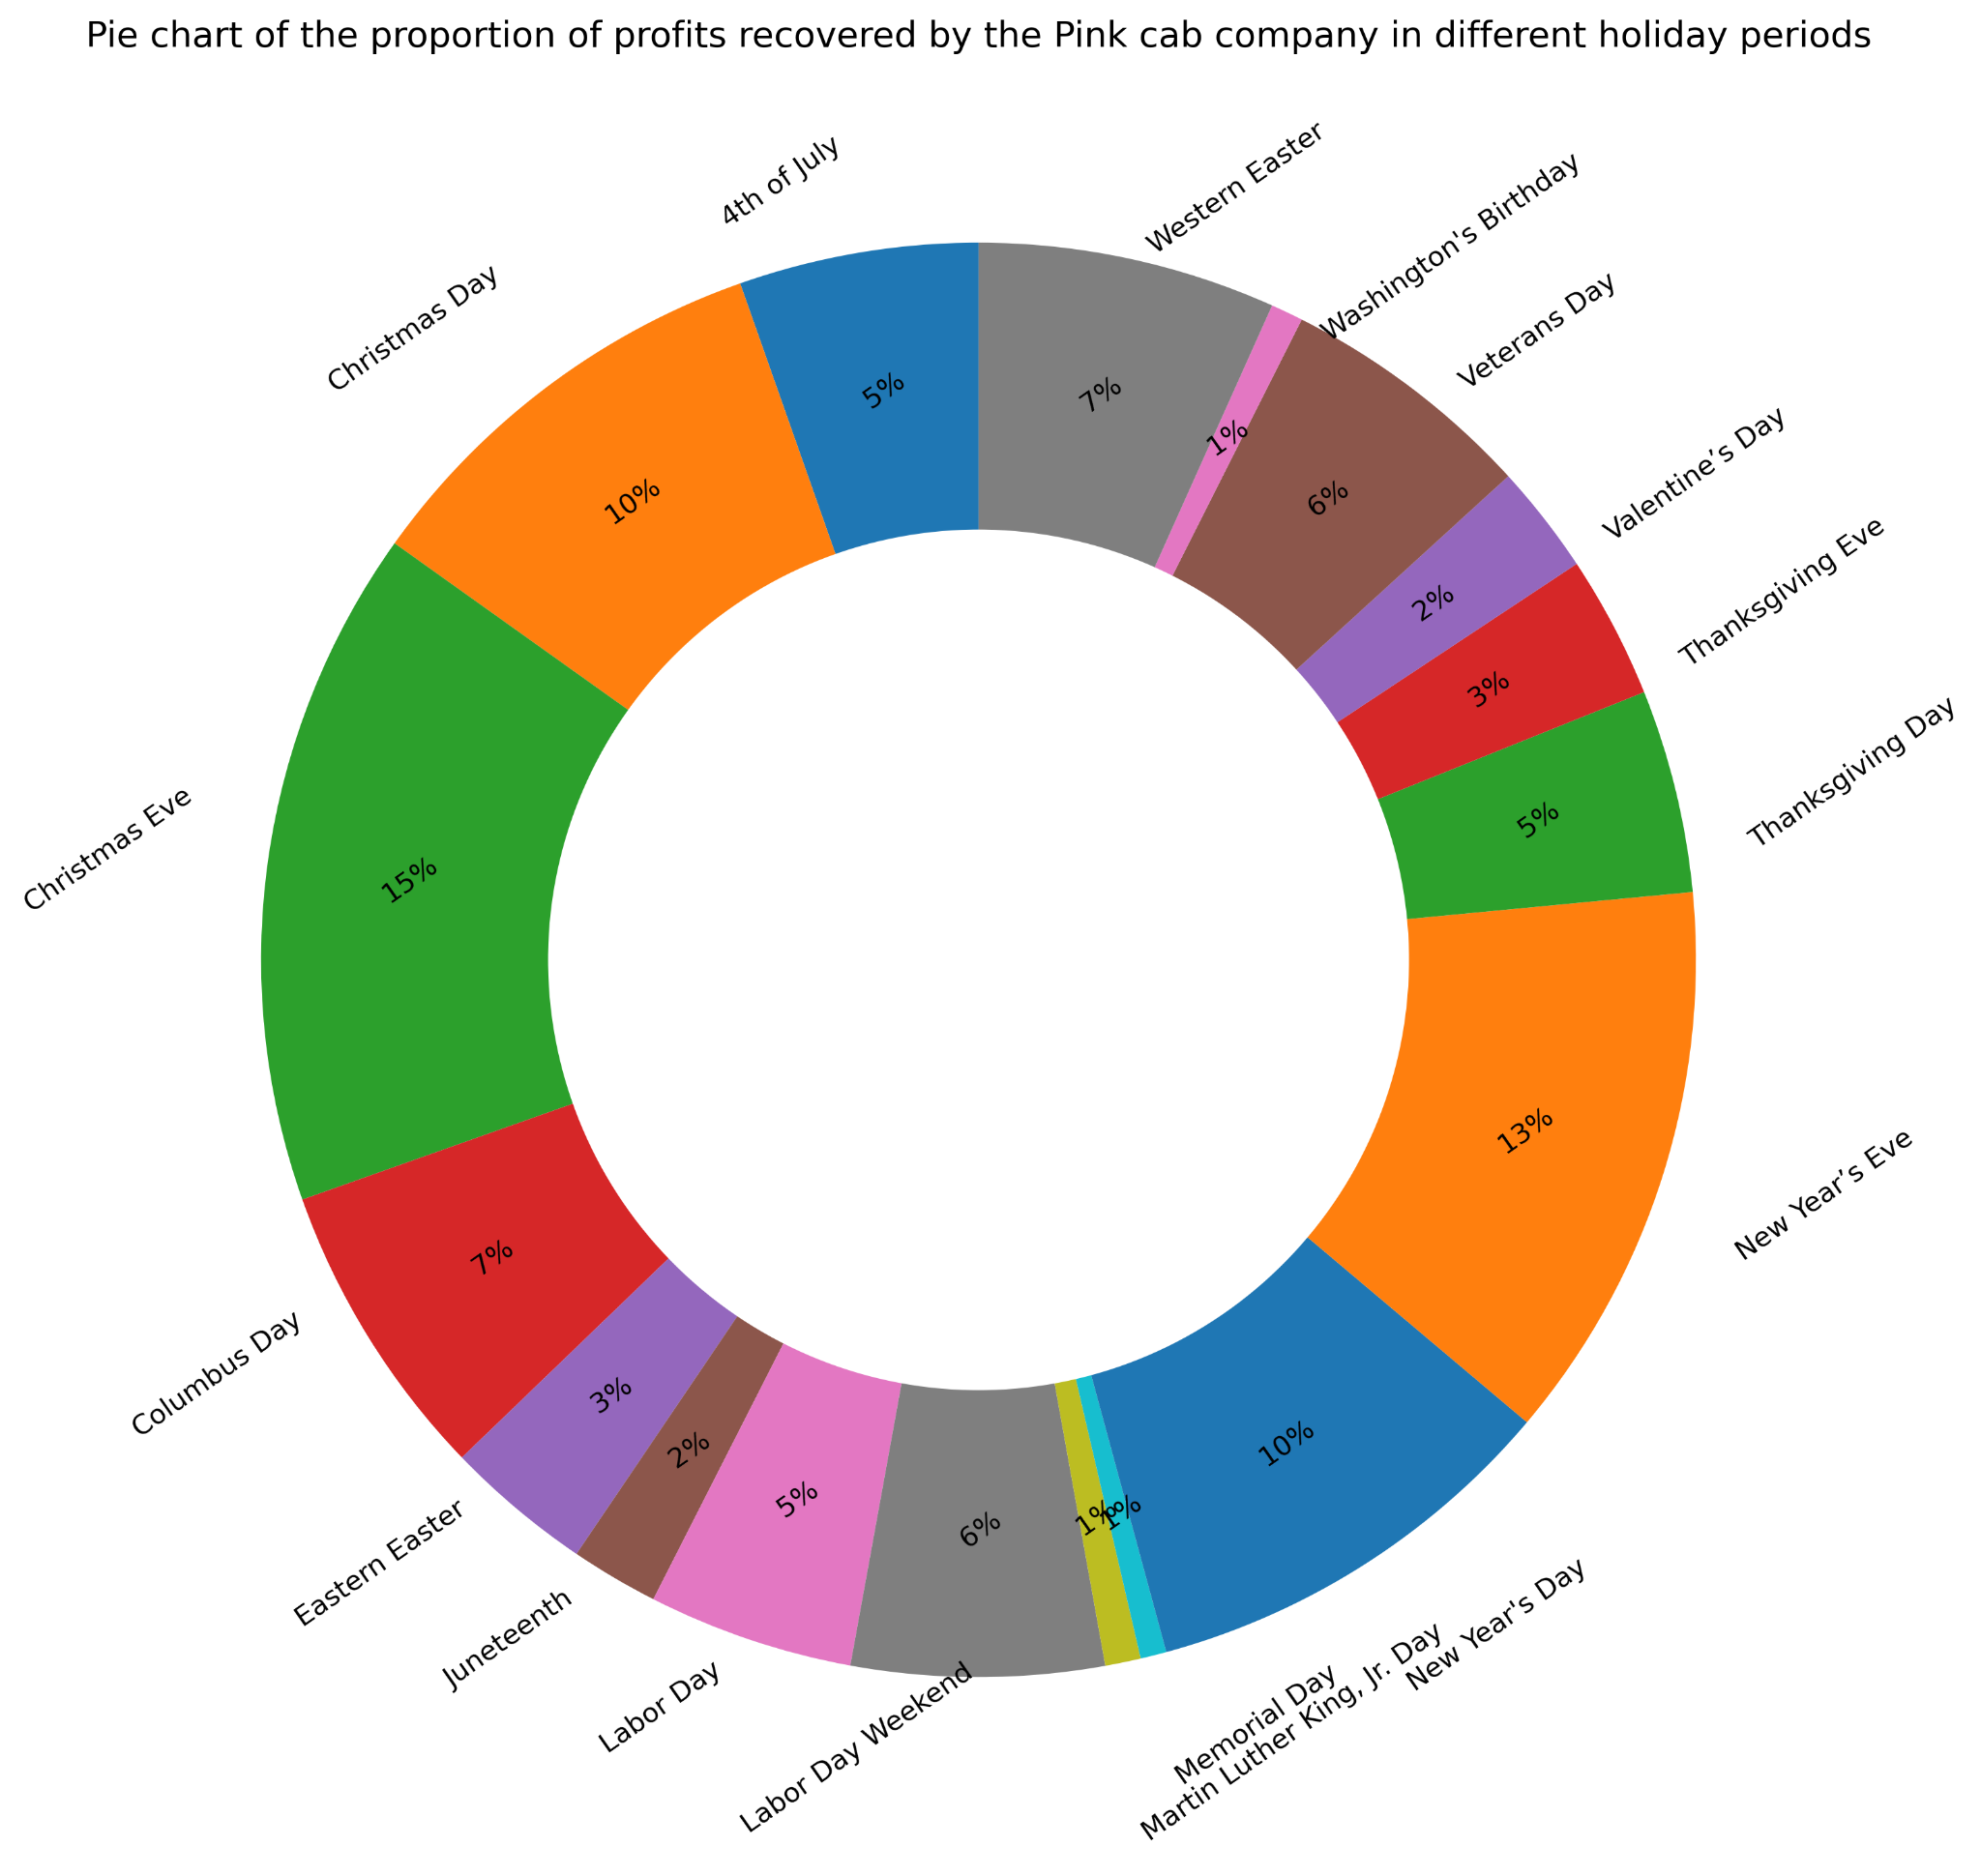

Slide 19
PROFIT ANALYSIS : PROFIT DISTRIBUTION YEARLY
While both companies made their highest of profits in 2017, we see that yellow cab made about 3 times the amount of profits made by Pink Cab firm in each of the years. In addition to that, we see that Yellow Cab firm made 7.57 times the total profit made by Pink Cab firm in all the years.
As shown below

Slide 20
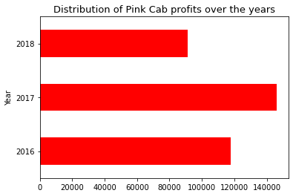
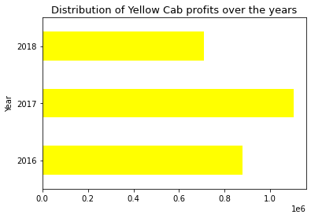

Slide 21
DEDUCTIONS
A larger population of individuals have Yellow Cab available to them than Pink Cab.
Yellow cab company charges slightly more on an average than the pink Cab Company.
They both travel at similar average kilometers.
As we see, a large majority of Yellow cab users are found in NEW YORK NY, CHICAGO IL & WASHINGTON DC with the least amount of users in PITTSBURG CA & SACRAMENTO CA.

Slide 22
DEDUCTIONS CONT”D
For Pink Cab we see that it has most of its users in LOS ANGELES CA, NEW YORK NY & SAN DIEGO CA with the least in PHOENIX AZ, PITTSBURG CA & SACRAMENTO CA
Overall we see that yellow cab is more patronised than pink cab in all of the 19 cities.
As we see the highest percentage of pink cab profits comes from NEW YORK NY, followed by LOS ANGELES CA & SAN DIEGO.
Highest profits earn by the yellow cab company is on Christmas Eve, New Year's Eve and Labor Day Weekend.
They both recorded the highest number of users in 2017 although the yellow cab company recorded more users in all the years than the pink cab company
For the pink cab company, profits are mostly made on Christmas eve, new year's day, Christmas day & new year's eve. However they make more overall on holidays than the yellow cab company
They both recorded the highest number of users in 2017 although the yellow cab company recorded more users in all the years than the pink cab company(three times as much)

Slide 23
CONCLUSION AND RECOMMENDATION
We see that the Yellow cab firm is the more popular cab firm as it is not only available to a larger population of individuals in America(especially in cities with the largest population), but also has a larger number of users than the Pink cab firm. This is the case regardless of the fact that they charge more on an average than their counterpart firm and travel same KM on an average. We still see that yellow cab makes 7.6 times the profit that Pink Cab makes in a year regardless of the fact that Pink cab makes more on holidays.
We will recommend Yellow Cab Firm for investment.

Slide 24
THANK YOU FOR YOUR TIME !

